Slide 1
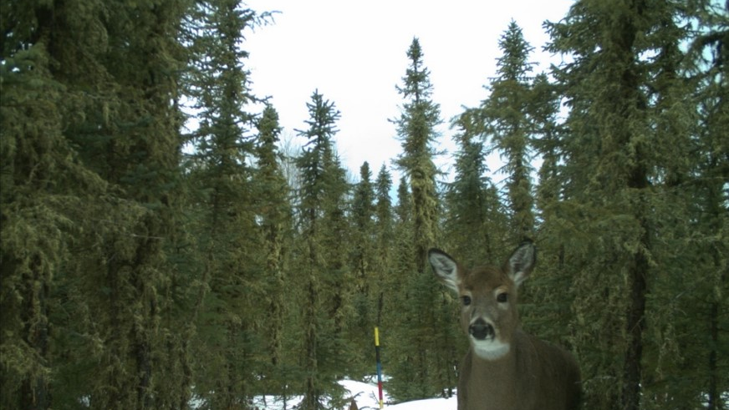
Automatic Wildlife Animal Detection in Camera Trap Images
Iacob Mihaela Iasmina Big Data, Year 2 Computer Vision

Slide 2
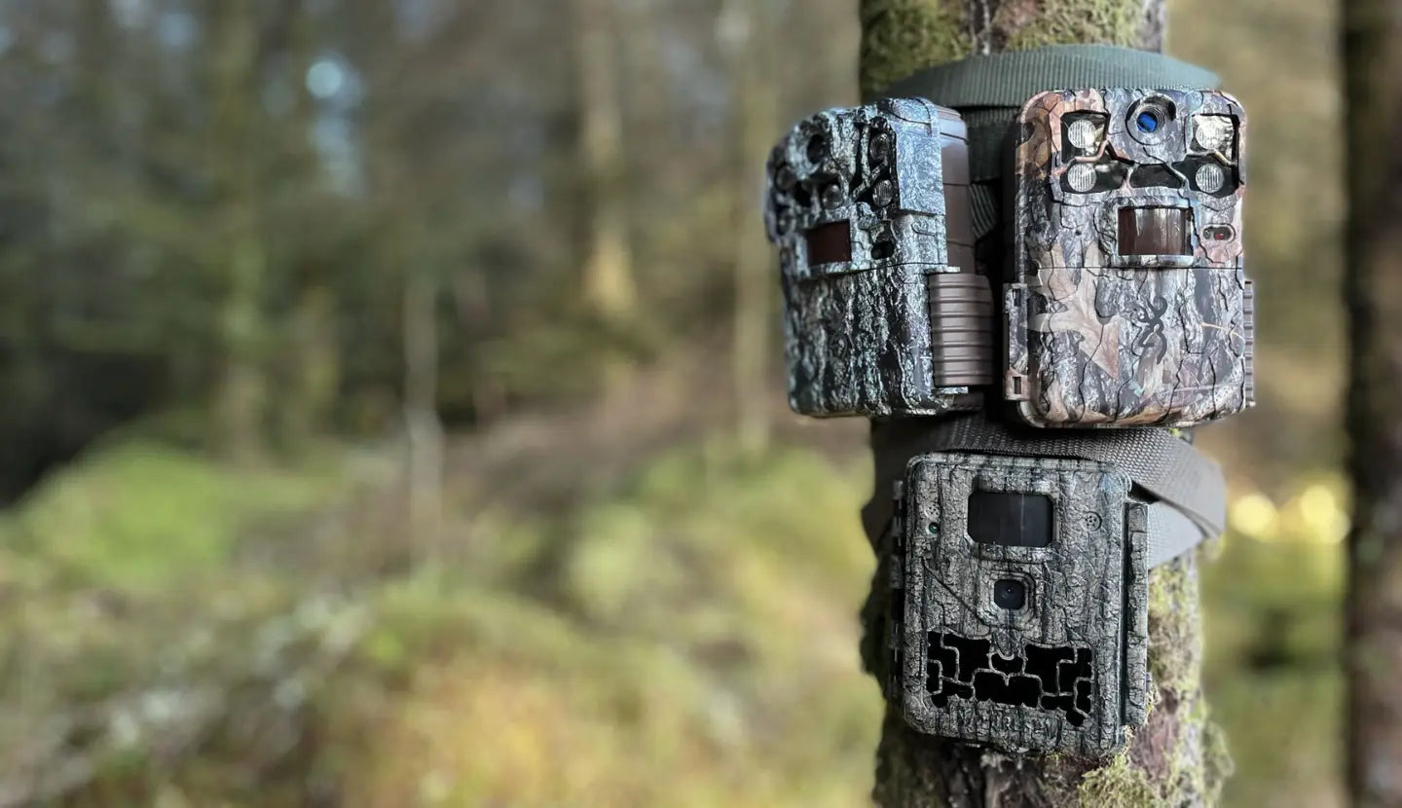
MOTIVATION
Camera traps collect millions of images, which makes manual review:
slow
expensive
error-prone
Wildlife monitoring is critical for:
biodiversity conservation
animal population tracking
ecosystem health
Goal: Automatically detect whether an animal is present in a camera trap image.

Slide 3
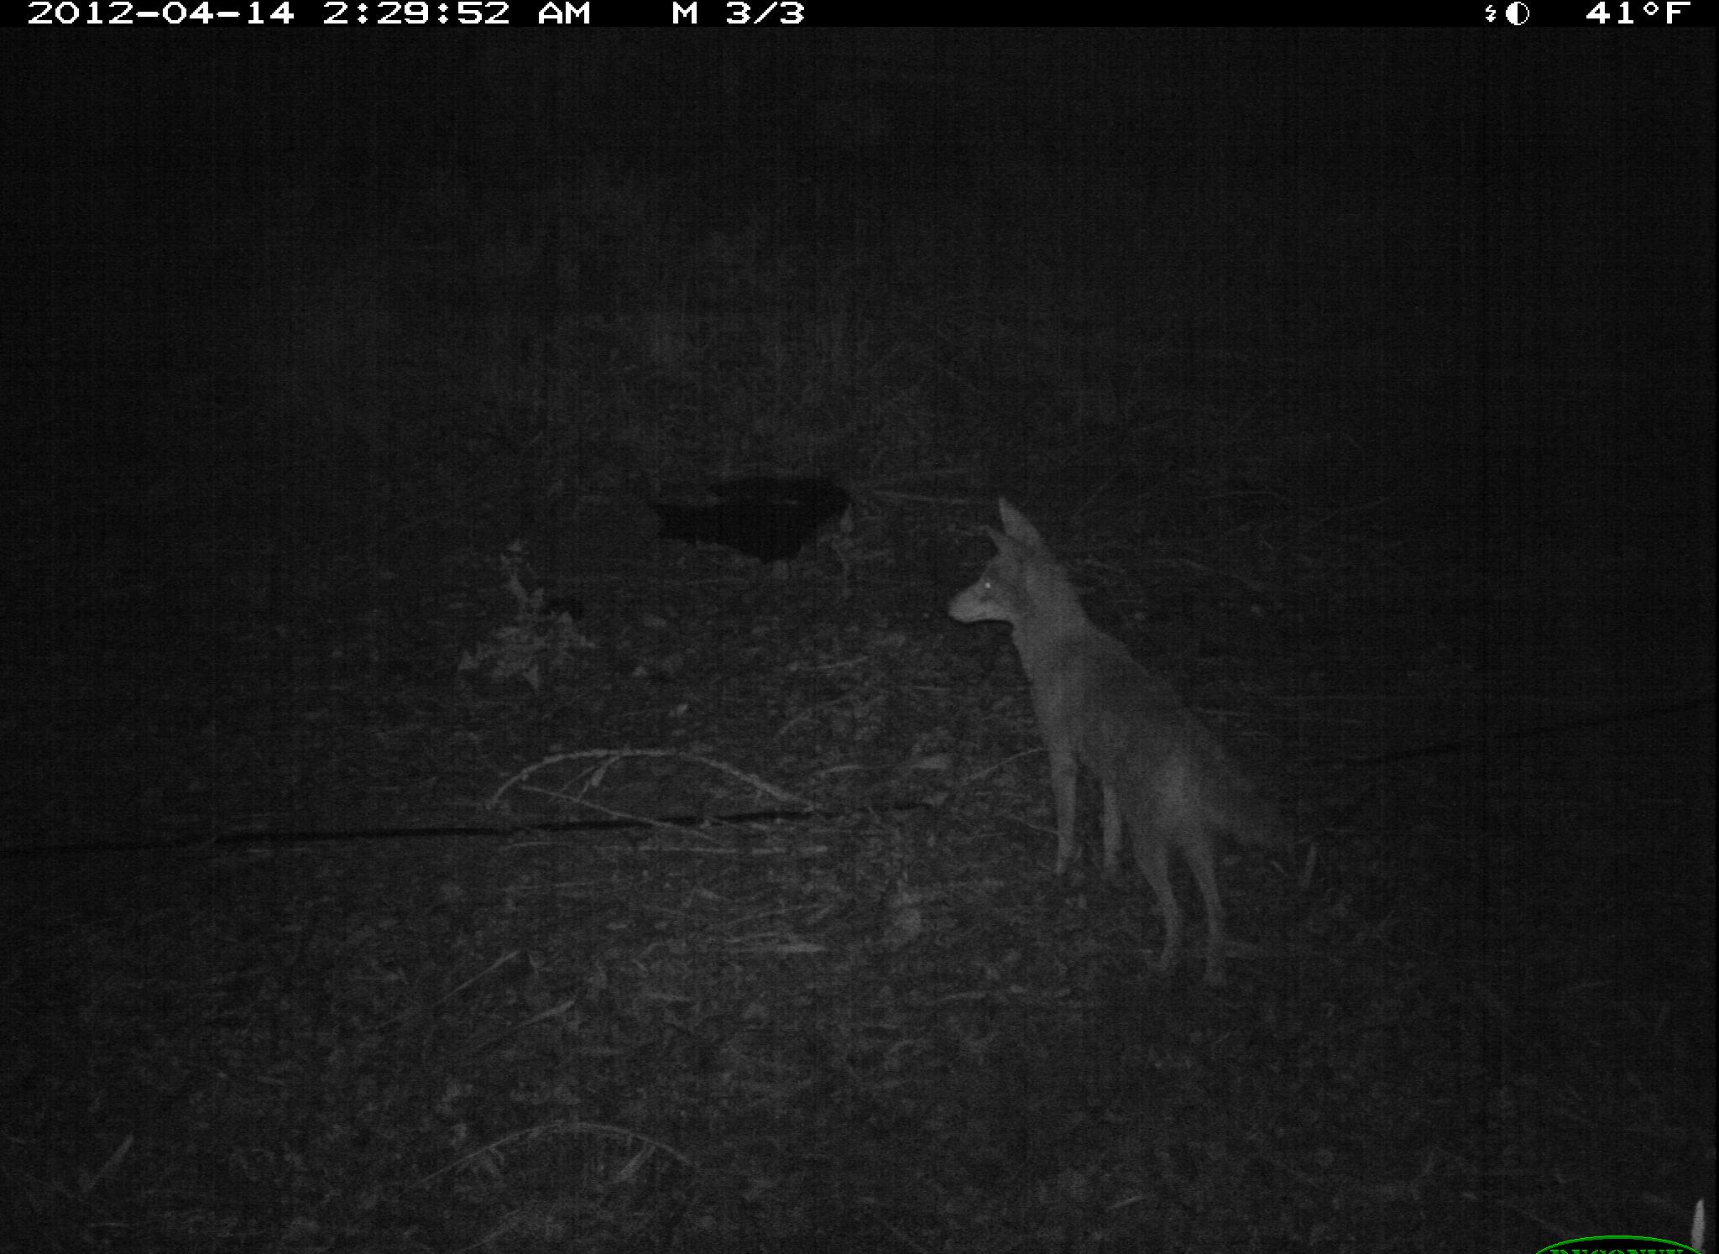
Dataset
Caltech Camera Traps (CCT)
~243,000 images from 140 camera locations
21 animal categories + “empty”
Most images are empty
Publicly available via LILA BC
Notes: images are downloaded on demand. Metadata provided in COCO Camera Traps format. No full dataset download required.

Slide 4
Problem Definition
Pipeline
Binary Classification Task
For each image:
Input: camera trap image
Output:
1 = animal present
0 = empty scene
This project does not use deep learning. It focuses on classical computer vision.
Load metadata and image sequences
Convert images to grayscale
Build a background model
Extract foreground (moving objects)
Clean foreground mask
Classify animal presence
Evaluate performance

Slide 5
Why Background Subtraction?
Camera traps are:
static
fixed viewpoint
Animals move, background does not.
Method used: OpenCV MOG2 background subtractor
Key decision:
Train background model on the first frame only
Prevent animals from being absorbed into background

Slide 6
Foreground extraction
Steps:
Absolute difference via MOG2
Binary thresholding
Morphological operations:
opening - remove noise
closing - fill gaps
Result: Binary mask highlighting moving regions (animals)

Slide 7
Animal Presence Classification
Decision Rule: Count number of foreground pixels (fg_area)
If:
fg_area >= threshold => animal present fg_area < threshold => empty
Threshold used: 300

Slide 8
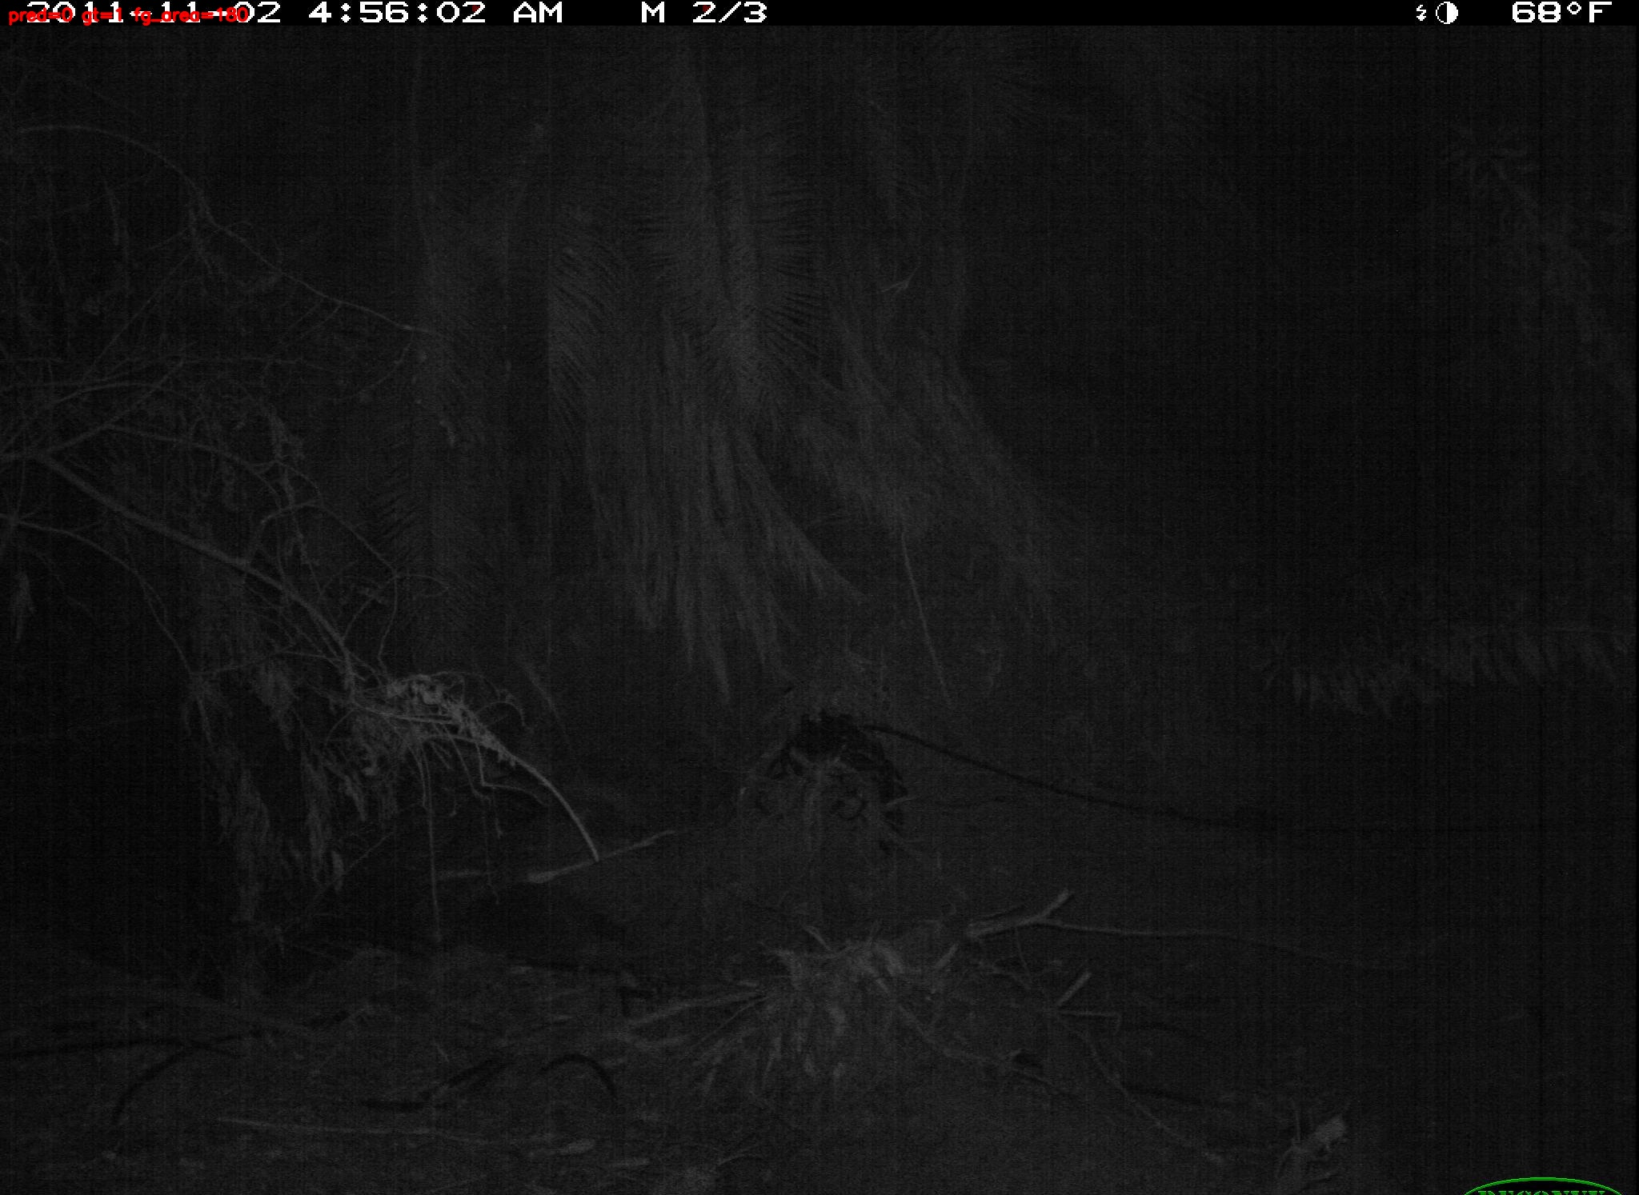
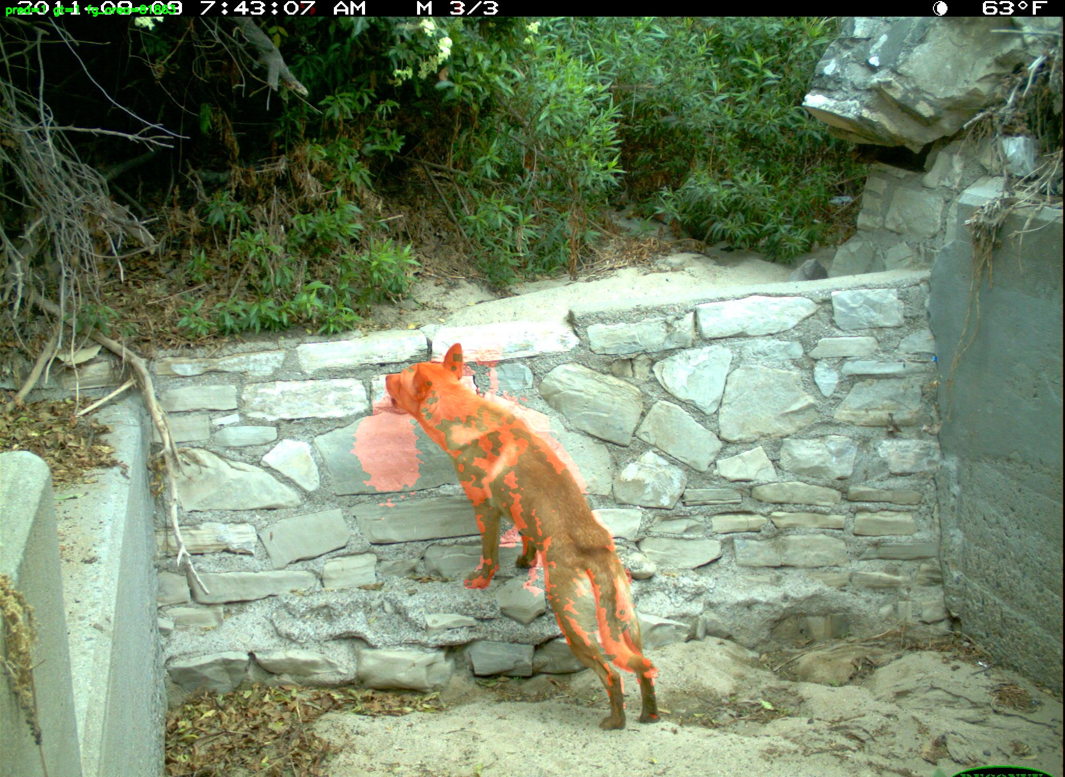
Results - visualization
-Foreground mask overlaid in red
-Text overlay:
predicted label
ground truth
foreground area
-Correct predictions shown in green
-Incorrect predictions shown in red
Added CSV report.

Slide 9
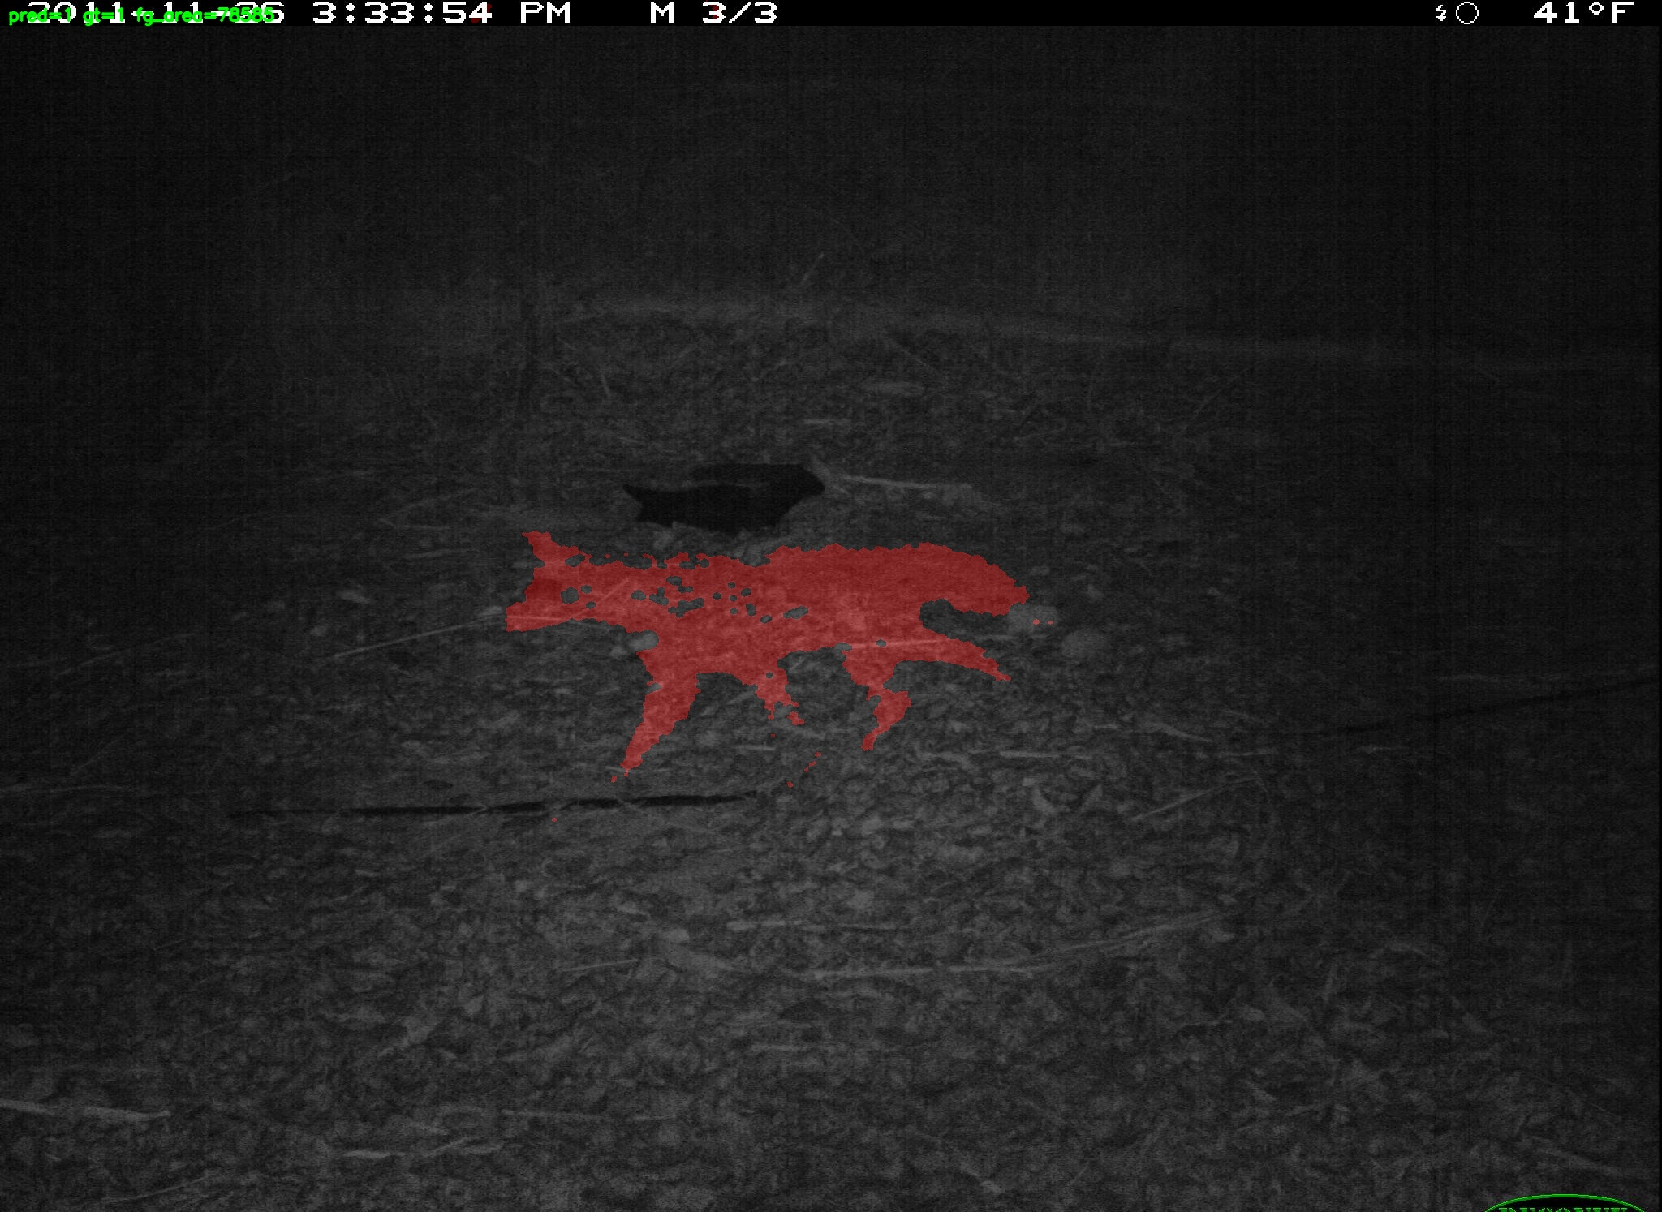
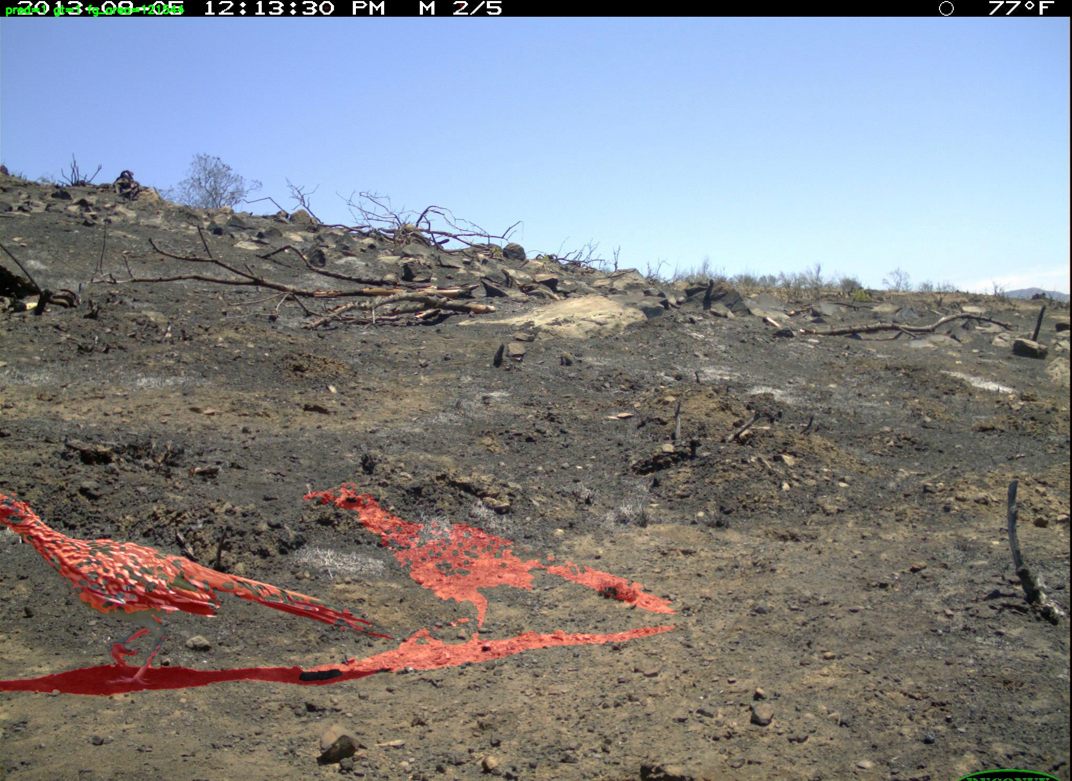
Results - Evaluation Metrics
Accuracy - 0.950
Precision - 0.982
Recall - 0.966
Confusion Matrix:
TP: 56
FP: 1
FN: 2
TN: 1

Slide 10
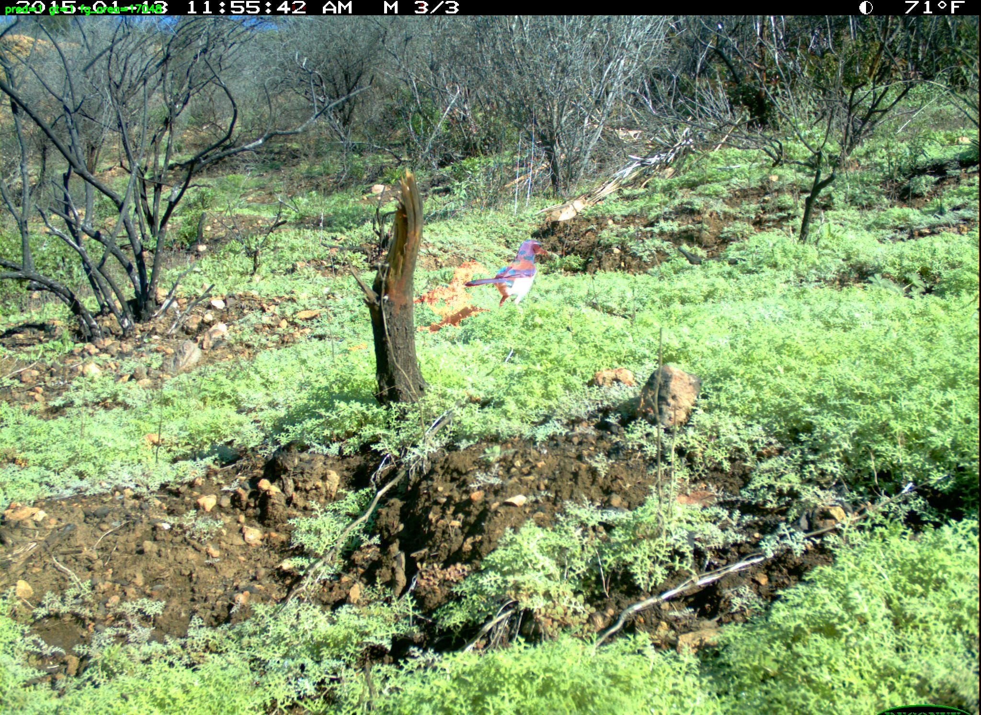
Interpretation of results
High precision (98%) - Very few false alarms
High recall (97%) - Most animals detected
Low TN count - Due to sampling bias toward animal-present sequences
If an animal walks across the scene, every place it was moving shows up as foreground.
Overall: Strong performance for a classical CV approach

Slide 11
strengths
limitations
No training required
No neural networks
Fast and lightweight
Interpretable decisions
Works well for static camera setups
Requires motion (static animals may be missed)
Sensitive to lighting changes
Short sequences only
Binary detection only (no species classification)

Slide 12
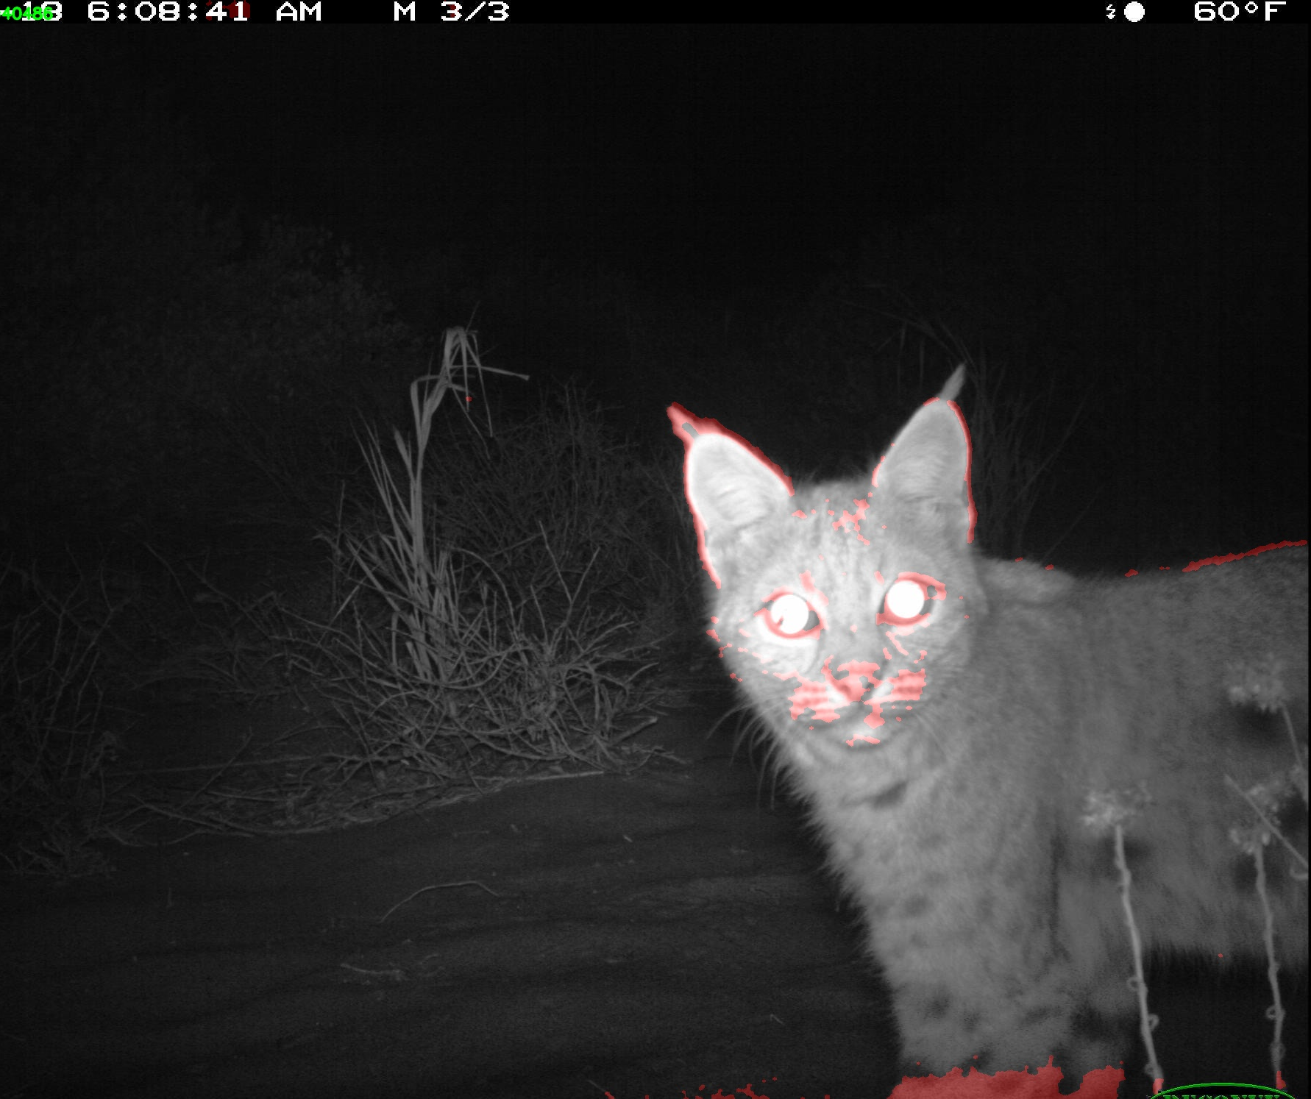
conclusion
Successfully built an animal presence detector
Used classical computer vision
Evaluated on a real-world wildlife dataset
Achieved high precision and recall
Demonstrated that simple CV methods remain effective
Can improve by doing: bounding box localization, temporal smoothing across frames, species classification, comparison with deep-learning detectors, adaptive thresholding
Thank you!

